Slide 1


TEEGALA KRISHNA REDDY ENGINEERING COLLEGE
(UGC-Autonomous)
Approved by AICTE, Affiliated by JNTUH, Accredited by NAAC- ‘A’ Grade Medbowli , Meerpet , Balapur ,Hyderabad, Telangana- 500097
Mob: 9393959597. Email: info@tkrec.ac.in, deanacademics@tkrec.ac.in
DEPARTMENT OF ELECTRONICS AND COMMUNICATION ENGINEERING
BATCH NO:06
SMART SHOE FOR THE BLIND PEOPLE USING ULTRASONIC SENSOR AND VOICE GUIDANCE
TEAM MEMBERS :-
22R91A04F4:M.NANDINI
22R91A04K2:P.SURESH
22R91A04H8:P.THARUN
22R91A04J7:P.NAVEEN
GUIDED BY:-
Mrs. S. PRATHYUSHA
(ASSISSTANT PROFESSOR)

Slide 2
Table of Contents
OBJECTIVE
ABSTRACT
BLOCK DIAGRAM
METHODOLOGY
ADVANTAGES AND APPLICATIONS
EXPECTED RESULT

Slide 3
OBJECTIVES
The goal of this initiative is to create smart shoe for blind people is to improve mobility and safety for visually impaired individuals.
It uses ultrasonic sensors to detect obstacles in real time. The system provides voice guidance to alert users about nearby obstacles.
This hands-free solution enhances independence and reduces reliance on traditional aids like canes. It aims to be an affordable and user-friendly assistive device.

Slide 4
ABSTRACT
This project presents a Smart Shoe for Blind People, integrating ultrasonic sensors and voice guidance to enhance mobility and independence.
The system employs ultrasonic sensors to detect obstacles in the user's path and provides real-time audio feedback via a voice module.
The ultrasonic sensors continuously scan the surroundings, and when an obstacle is detected within a predefined range, a microcontroller processes the data and triggers voice alerts through a speaker
This innovation aims to improve the safety and autonomy of visually impaired individuals, reducing
their dependency on traditional aids like canes. The smart shoe is a cost-effective, lightweight, and user- friendly solution, making it a viable option for widespread adoption.
Keywords: Smart Shoe, Ultrasonic Sensor, Voice Guidance, Assistive Technology, Blind Navigation

Slide 5

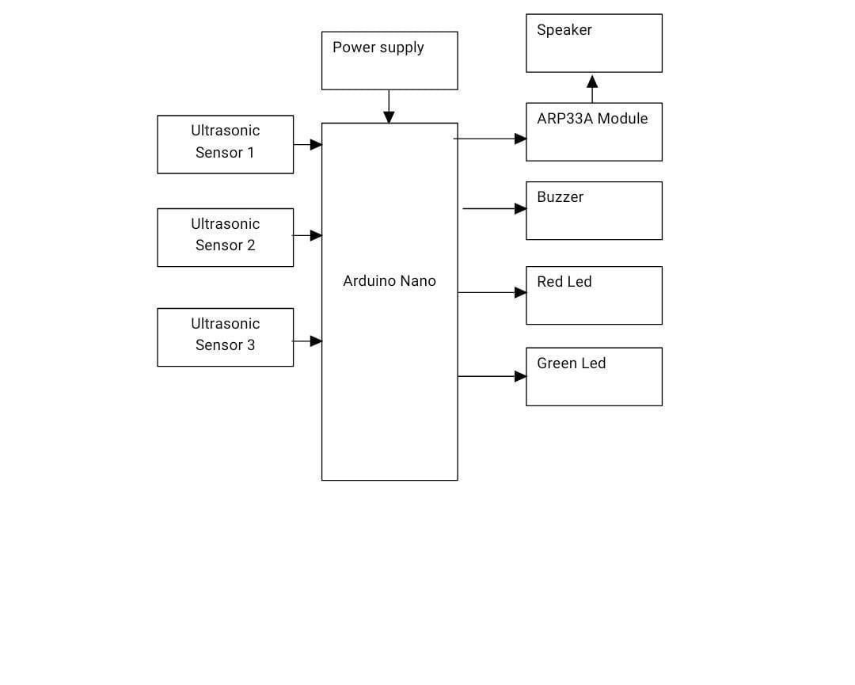



BLOCK DIAGRAM
Ultrasonic sensor4

Slide 6
METHODOLOGY
The smart shoe is designed to help visually impaired individuals navigate safely using ultrasonic
sensors and voice guidance.
Ultrasonic sensors are placed at the front and sides of the shoe to detect obstacles within a specific range.
A microcontroller processes the sensor data and determines the distance of obstacles.
When an obstacle is detected, a voice module or Bluetooth-connected earphones provide real-time audio alerts.
The system is powered by a rechargeable battery to ensure continuous operation.
A prototype is developed and tested in real-world conditions to evaluate its effectiveness.
Feedback from visually impaired users is collected to optimize the system for better accuracy and usability.
Future improvements may include GPS integration for advanced navigation and smartphone connectivity for additional features.

Slide 7
Advantages and Applications
Advantages:
Enhanced Mobility
Hands-Free Operation
RealTime Alerts
Lightweight an Comfortable
User-Friendly
Applications:
Daily Navigation
Public Transport Assistance
Educational Institutions
Hospitals and Rehabilitation Centers
Smart Cities and Accessibility

Slide 8
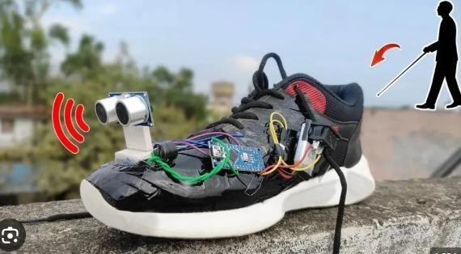
EXPECTED RESULT

Slide 9
Thank you...

